Slide 1
Leadership Development
Abbey Hellickson, M.Ed.
Business Growth Consultant

Slide 2
Agenda
Talent Management
Leadership Development
Action Plan

Slide 3
Today’s Objectives
Describe the impact leaders have on an organization
Describe steps to develop leaders
Create an action plan

Slide 5
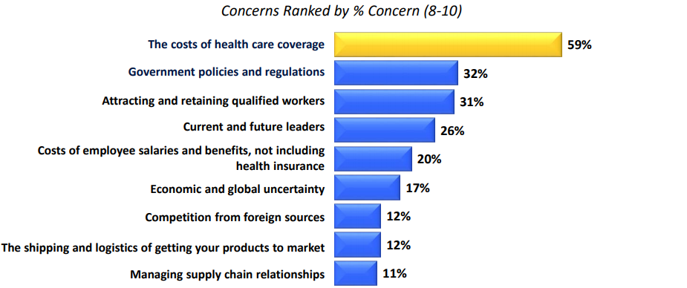
2017 State of Manufacturing

Slide 6
Leaders
What impact does a leader have on an organization?
Why focus on leadership development?
What happens if we don’t focus on development of leaders?

Slide 7
Talent Management & Leadership Development Key to Competitive Advantage

Slide 8
“Leaders are not born; they are grown.”
- Peter Drucker, Harvard Business Review

Slide 9
Steps to Leadership Development
Align to business strategy and talent management plan
Employee involvement
Identify leadership competencies
Identify current and potential leaders
Identify current and future skills gaps
Implementation of development
Measure and evaluate

Slide 10
Step 1: Align to Business Strategy and Talent Management Plan
Business Strategy
Talent Management
Team Plan
Individual Plan

Slide 11
Step 2: Employee Involvement
Organization Needs
Individual Needs
Desired
Competencies
Values
Strategy
Goals
Mission
Vision
Development
Needs
Annual
Goals
IDP
Open Positions &
Opportunities
Strengths
Career
Plans
(Individual Development Plan)
Adapted from Talent
Management Formula
— Bersin by Deloitte

Slide 12
Step 3: Identify Leadership Competencies
Determine the competencies most important to your business
Create the foundation for development
Establish the competencies for leaders at different levels
Frontline
Middle Management
Senior Level

Slide 13
Step 4: Identify Leaders
Identify current and potential leaders
Review their competencies
Review their performance

Slide 14
Step 5: Identify Skills Gaps
Analyze and monitor current skills gaps
Analyze and monitor future skills gaps
Create a leadership skills matrix

Slide 15
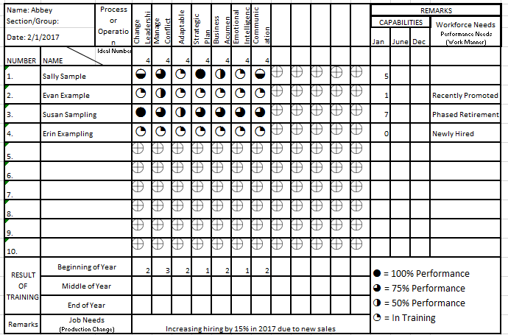
Leadership Skills Matrix Example

Slide 16
Step 6: Implementation of Development
Prioritize skills focus
Create an IDP
(Individual Development Plan)
Implement and support development activities
Applied development
Mentoring and coaching
Development opportunities
Peer groups

Slide 17
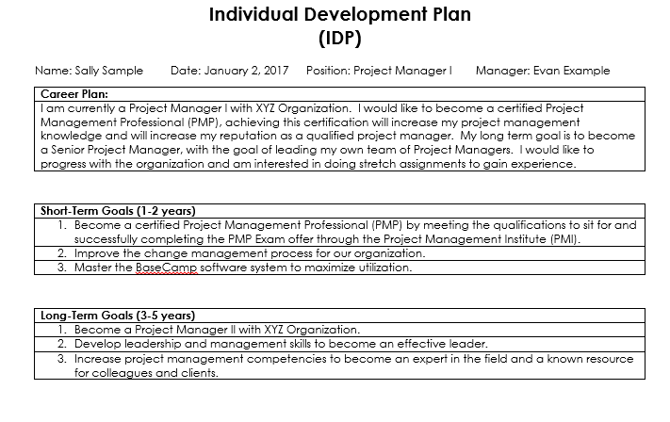

Slide 18
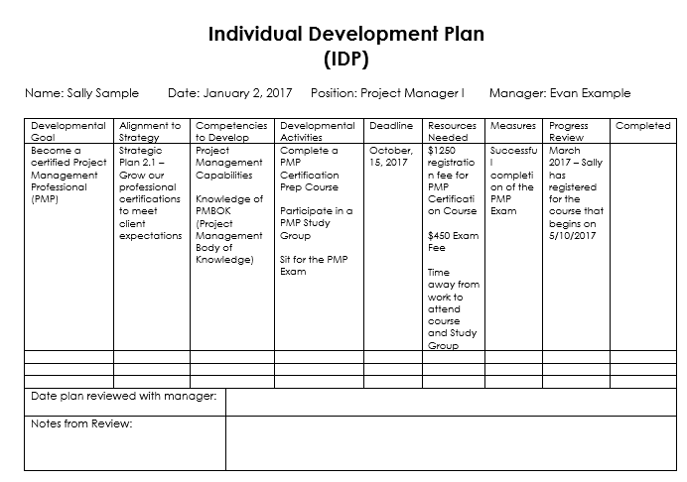

Slide 19
Step 7: Measure and Evaluate
Create metrics as part of development program
Conduct pre and post assessments and compare results
Evaluate your development activities
Consider impact on results

Slide 20
Action Plan
What is one thing you learned from the session today?
What will you implement from today’s session in your organization?

Slide 21
Putting it All Together
Competitive
Advantage
Individual
Development
Leadership
Development
Talent
Management
Business
Strategy

Slide 22
Thank you
Abbey Hellickson
Enterprise Minnesota
Business Growth Consultant
Abbey.Hellickson@enterpriseminnesota.org

